Slide 1

Materials Engineering and Operational Design Windows for High Performance Fusion Systems
S. Zinkle⁽¹⁾, S. Sharafat⁽²⁾, and N.M. Ghoniem⁽³⁾
  ⁽¹⁾Oak Ridge National Laboratory, Oak Ridge, TN. 37831-6376
  ⁽²⁾Lambda Optics Inc., Fremont CA. 94538
  ⁽³⁾University of California Los Angeles, Los Angeles CA. 90095
Chamber Technology Peer Review Meeting
University of California Los Angeles
April 27th, 2001

Slide 2
Title of Work: Materials Engineering for High Power Density
Principal Investigator and Institution: Steve Zinkle (ORNL), Shahram Sharafat (UCLA) & Nasr M. Ghoniem (UCLA)
Overall Objective: Assess structural materials database and suggest operating temperature regimes. Select appropriate structural materials for high power density applications.
Technical Approach: (1) Evaluation of property data; (2) phenomenological compatibility models; (3) mechanisms of failure models.
Accomplishments:
  Established the operating temperature windows for structural materials;
  Developed design equations for mechanical properties;
  Developed chemical compatibility models for coatings in liquid metals and Flibe.
Relevance to OFES/Fusion: Development of a materials data base and design equations provide guidance to materials development efforts, and validate design concepts.
Funding (past 2 years): FY00 $80K FY01 $55K

Slide 3

Presentation Outline
Structural materials considered
Selection criteria of material systems
Critical analysis of operational windows
Experiment-based compatibility modeling
Conclusions and future directions

Slide 4
Structural Materials Considered for APEX
Low Activation Materials:
  Vanadium alloys
  Ferritic/ martensitic (8-9% Cr) steels, ODS steels.
  SiC/SiC composites
Composites:
  C/C
  Metal matrix Cu-C
  Ti3SiC2 composites
Refractory Alloys:
  Nb-1 Zr, Nb-18W-8Hf
  T-111 (Ta-8W-2Hf), Mo-Re
  W-5Re, W-25Re
Intermetallics:
  TiAl
  Fe₃ Al
Ni-Based Superalloys
Porous-matrix metals and Ceramics.
The Materials Subgroup Assembled and Developed Design Equations for Thermal, Physical and Mechanical Properties of Liquid Coolants and Structural Materials.

Slide 5
Factors Affecting Selection of Structural Materials
Availability, cost, fabricability, joining technology
Unirradiated mechanical and thermophysical properties
Radiation effects (degradation of properties)
Chemical compatibility and corrosion issues
Safety and waste disposal aspects (decay heat, radioactivity, etc.)
Nuclear properties (impact on tritium breeding, solute burnup, etc.)

Slide 6
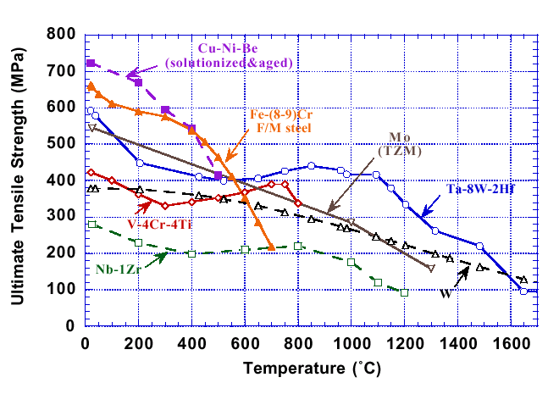
Ultimate Tensile Strength of Recrystallized Refractory Alloys, Cu-2%Ni-0.3%Be and Fe-(8-9%)Cr Ferritic-martensitic Steel

Slide 7
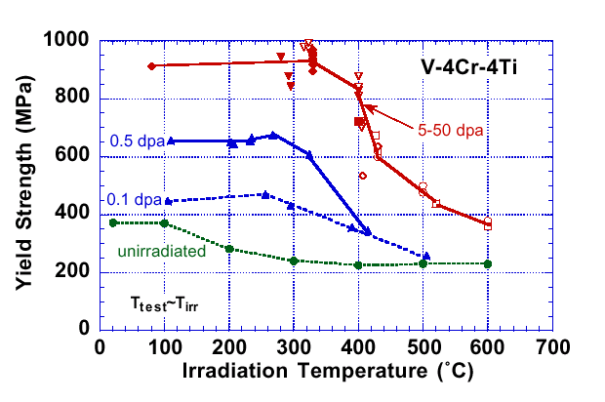
Effect of Irradiation Temperature and Dose on the Yield Strength of V-4Cr-4Ti

Slide 8
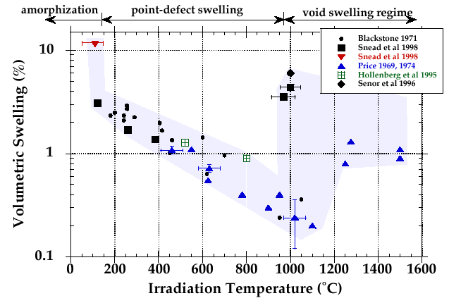
Volumetric Swelling Data for Monolithic SiC

Slide 9
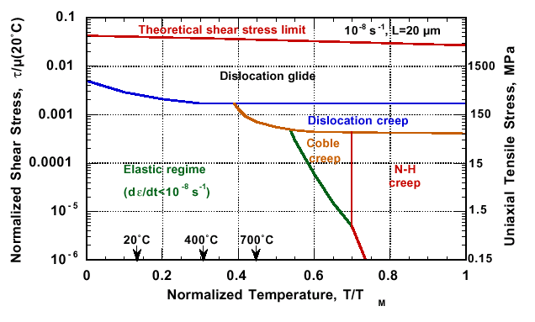
Calculated Deformation Map for V-4 Cr-4 Ti

Slide 10
Need for Thermodynamic Stability Analysis Model
Tin-lithium (Sn-25li) was identified as a potential new liquid wall coolant (compared with Pb-Li, Sn has lower density, lower vapor pressure, higher thermal conductivity).
.
MHD considerations necessitate ceramic coatings for many designs.
.
Critical issues:
  Stability of ceramic coatings.
  Compatibility of oxides, nitrides, and carbides with Li, Li-Pb, and Sn-Li.
  .
Lack of data → need thermodynamic stability analysis model to guide.
.

Slide 11
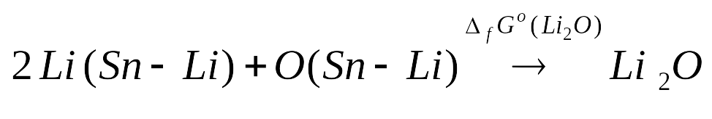
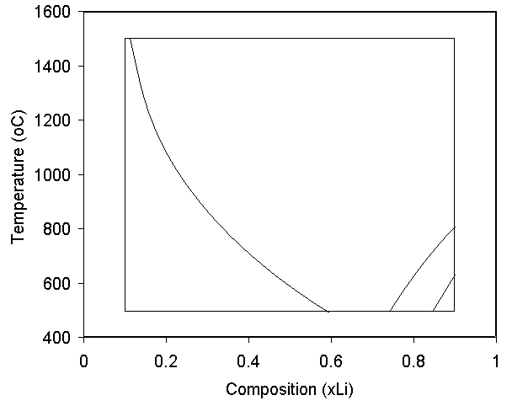
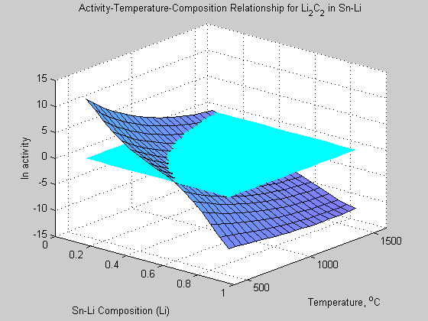
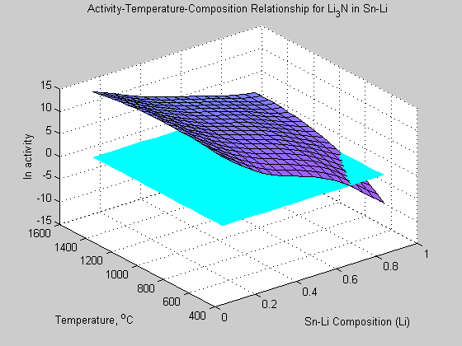
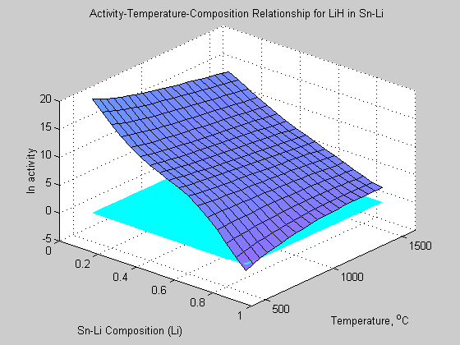
Thermodynamic Stability Regimes For Carbides, Nitrides and Hydrides
in Sn-Li
MODEL
Li₂C₂
Solute Activity
Li₂C₂
Δ_{f}Gº(Li₂O) = RT ln K_{e} = RT ln { a_{Li2O}/a²_{Li} ·a_{O}}
Gibbs Free Energy
ln a_{O} = {−Δ_{f}Gº(Li₂O)/RT} - 2 ln a_{Li}
Oxygen Activity
Li₃N
positive
activity
negative
activity
Li₃N
25 at.% Li
LiH
LiH

Slide 12
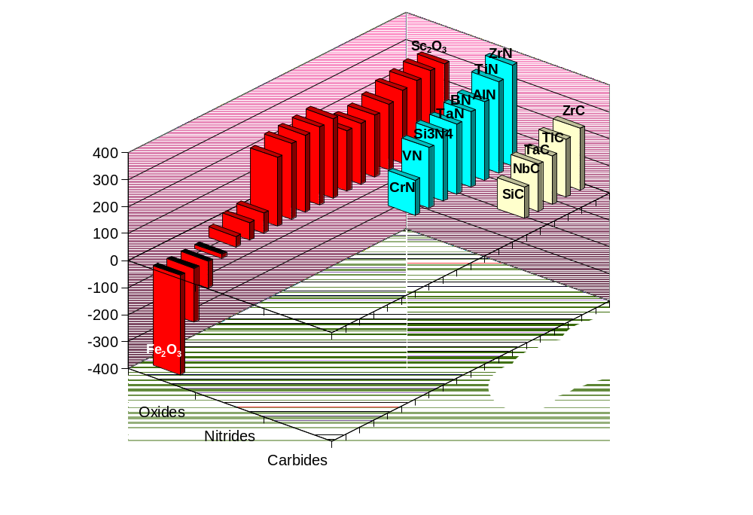
Predicted Stability of Various Carbides, Nitrides and Oxides in Sn-25Li @ 773K
Stable
ΔG_{r}
(kJ/mol)
Unstable

Slide 13
Summary of Ceramic Coating Thermodynamic Compatibility with Sn-25Li
The most stable ceramics are nitrides, followed by oxides, and then carbides.
  –Nitrides: The considered nitrides are stable at 773K.
ZrN being the most stable nitride.
  –Oxides: The most stable oxides are: Sc₂O₃ and Y₂O₃
Fe₂O₃, NiO, and Cr₂O₃ decompose.
All other considered oxides were found to be stable.
TiO₂ & SiO₂ marginally stable.
B₂O₃ is unstable at Li-fractions above 0.2.
  –Carbides: All carbides including SiC were found to be stable
ZrC is the most stable carbide.

Slide 14
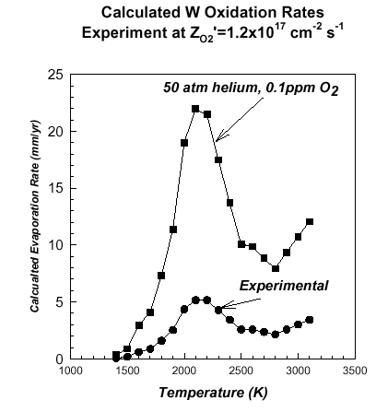
High-Temperature Oxidation of
Refractory Alloys
At Normal temperatures and pressures, the chemical reaction of a gas with the solid generally results in condensed products.
At high temperatures and low pressures, the formation of volatile products is thermodynamically favored over the growth of the condensed phase.
The upper temperature limit for design with refractory metals with a helium coolant will be influenced by the formation of volatile oxides.
  Determine the upper limit of Oxygen impurity levels for W/He designs using Thermodynamics of Chemical Reactions.

Slide 15
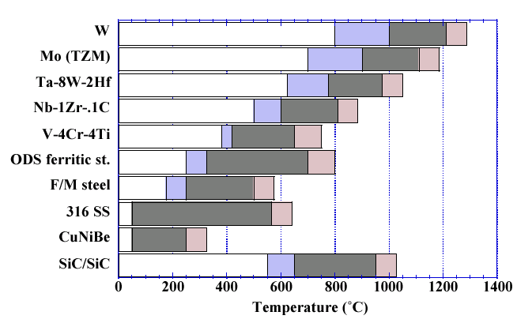
Operating Temperature Windows (based on radiation damage and thermal creep)
Upper uncertainty
Lower uncertainty
Suggested Range

Slide 16

Conclusions and Recommendations
Minimum temperature limit:
  BCC alloys >> radiation hardening and embrittlement.
  SiC/SiC composites >> thermal conductivity degradation, amorphization.
Upper temperature limit:
  BCC alloys >> thermal creep, helium embrittlement, or chemical compatibility (including oxidation).
  SiC/SiC >> void swelling or chemical compatibility.
Liquid metal compatibility >> most stable oxides (sc₂o₃ and Y₂O₃), carbides (ZrC), nitrides (ZrN). Uncertainty exists in kinetics.
Additional issues to be considered >> transmutation effects (long term activation and burnup of alloy elements), afterheat/safety (including volatization), and availability/ proven resources.

Slide 17
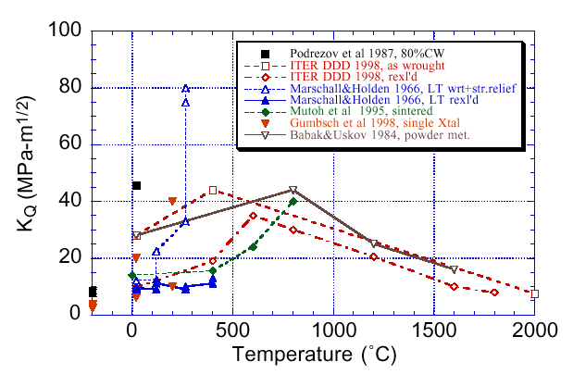
Temperature-dependent Fracture Toughness of Pure Tungsten in Various Thermomechanical Conditions

Slide 18
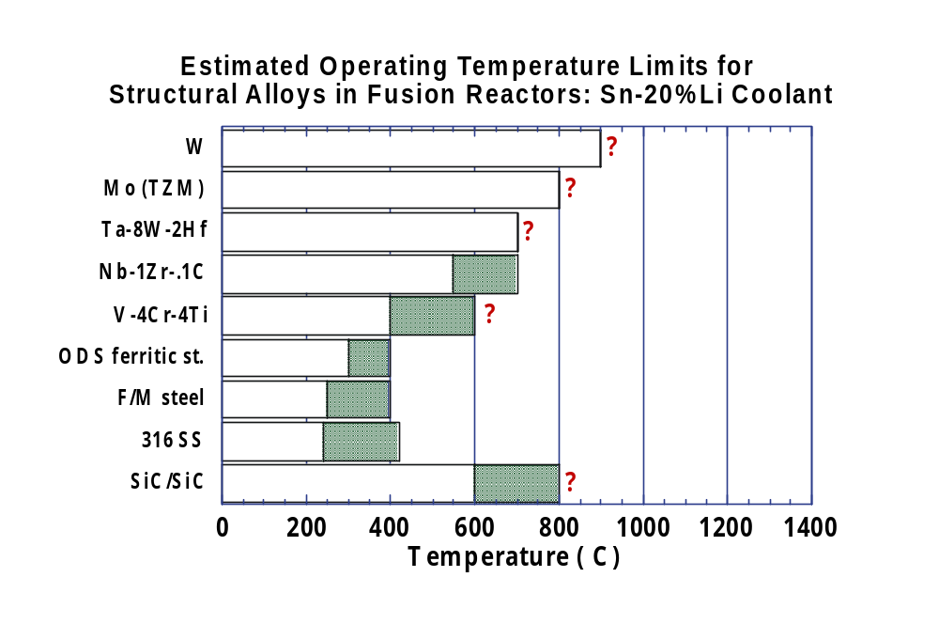
Operating Temperature Windows (based on Sn-Li Compatibility)
? Insufficient Data

Slide 19
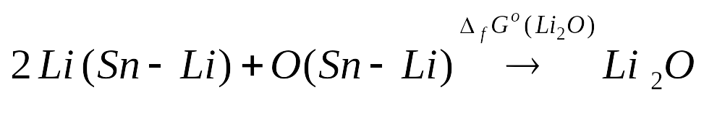
Thermodynamic Stability Analysis Model
Activity of solute (O, C, N, H) is first calculated for saturated solutions under equilibrium conditions (example O):
For the Li₂O chemical reaction
Δ_{f}Gº is the standard Gibbs Free Energy of formation, which is given by:
Δ_{f}Gº(Li₂O) = RT ln K_{e} = RT ln { a_{Li2O}/a²_{Li} ·a_{O}}
The activity of oxygen and the other three non-metal solutes (C, N, H) can be calculated using the standard free energy of formation:
 ln a_{O} = {−Δ_{f}Gº(Li₂O)/RT} - 2 ln a_{Li}
Data for the Gibbs Free Energy of Formation of Li₂O, Li₂C₂, Li₃N were found in the JANAF tables.

Slide 20
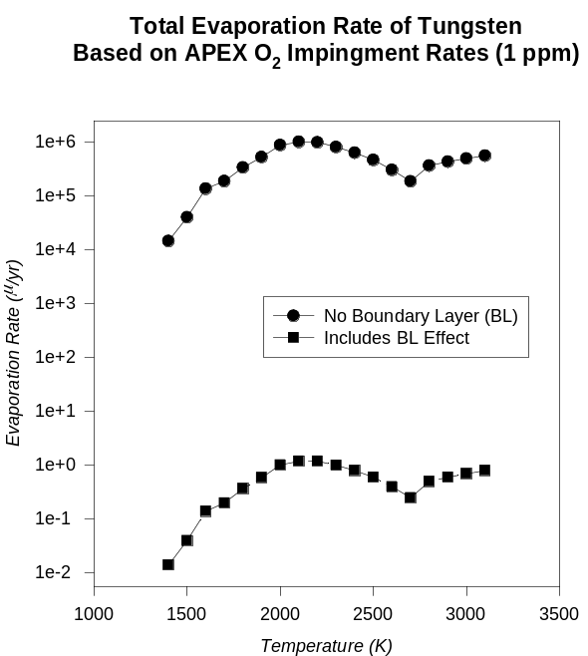
Effects of Boundary Layers on Evaporation Rate of Refractory Oxides
Use of quasi-equilibrium treatment of heterogeneous reactions, plus boundary layer effects to determine the actual evaporation rates.
Based on experimental data, the impingement rate of O₂ was used to determine:
  Static Evaporation Rates.
  Effects of the Boundary Layer Resistance To Oxide Product
Evaporation Rates Could Be As Low As
0.1 μm/yr for W at 1 ppm O₂ @ 1500ºC.
For an oxidation rate limit of 0.1 μm/yr the operating temperature for W is 1600ºC.
No Boundary Layer
With Boundary Layer

